Slide 1
Machine Learning
Lecture 5 (Bayesian Learning)
Course Instructor: Dr. Shahid Iqbal
Fall 2020

Slide 2
Bayesian Learning
Features
Each observed training example can incrementally decrease or increase the estimated probability that a hypothesis is correct.
This provides a more flexible approach to learning than algorithms that completely eliminate a hypothesis if it is found to be inconsistent with any single example.
Prior knowledge can be combined with observed data to determine the final probability of a hypothesis.

Slide 3
Bayesian Learning
Features
Bayesian methods can accommodate hypotheses that make probabilistic predictions (e.g., hypotheses such as "this pneumonia patient has a 93% chance of complete recovery").
New instances can be classified by combining the predictions of multiple hypotheses, weighted by their probabilities.

Slide 4
Bayes Theory
We are interested in determining the best hypothesis from space H, given the observed training data D.
One way is to demand the most probable hypothesis, given the data D plus any initial knowledge about the prior probabilities of the various hypotheses in H.
Bayes theorem provides a way to calculate the probability of a hypothesis based on its prior probability, the probabilities of observing various data given the hypothesis, and the observed data itself.

Slide 5
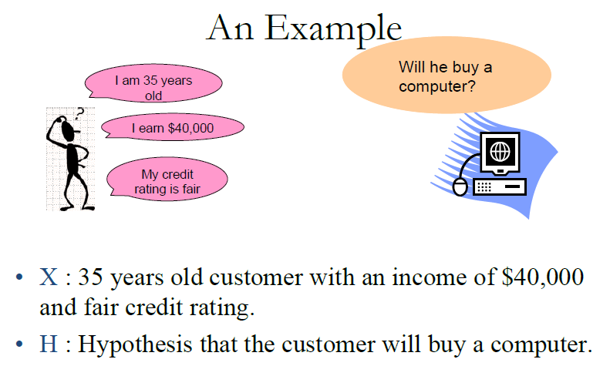

Slide 6
The Bayes Theorem
The Bayes Theorem:
  P (h | x) = P (x | h) . P (h) / P (x)
P(h | x) : Probability that the customer will buy a computer given that we know his age, credit rating and income. (Posterior Probability of h)
P(h) : Probability that the customer will buy a computer regardless of age, credit rating, income (Prior Probability of h)
P(x | h) : Probability that the customer is 35 yrs old, have fair credit rating and earns $40,000, given that he has bought our computer (Posterior Probability of x)
P(x) : Probability that a person from our set of customers is 35 yrs old, have fair credit rating and earns $40,000. (Prior Probability of x)

Slide 7
Choosing Hypotheses
Generally, we want the most probable hypothesis given the observed data
  Maximum a posteriori (MAP) hypothesis
  Maximum likelihood (ML) hypothesis

Slide 8
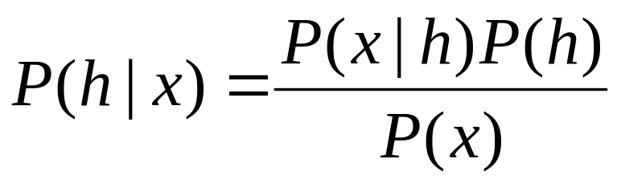
Maximum a posteriori (MAP)
Maximum a posteriori (MAP) hypothesis
Note P(x) is independent of h, hence can be ignored.

Slide 9
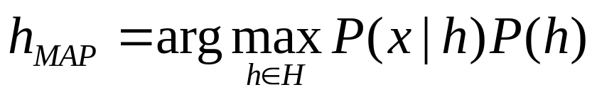
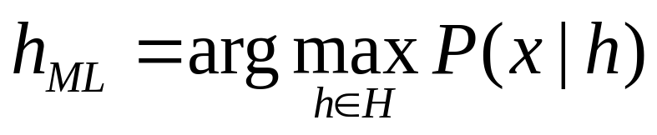
Maximum Likelihood (ML)
Assuming that each hypothesis in H is equally probable, i.e., P(h_{i}) = P(h_{j}), for all i and j, then we can drop P(h) in MAP. P(x |h) is often called the likelihood of data x given h. Any hypothesis that maximizes P(x | h) is called the maximum likelihood hypothesis

Slide 10
An Illustrating Example
Consider a medical diagnosis problem in which there are two alternative hypotheses:
(1) Patient has a particular form of cancer, (2) patient has not.
We have prior knowledge that over the entire population of people only .008% have this disease.
Furthermore, the lab test is only an imperfect indicator of the disease. The test returns a correct positive result in only 98% of the cases in which the disease is actually present
And a correct negative result in only 97% of the cases in which the disease is not present.
In other cases, the test returns the opposite result.

Slide 11
An Illustrating Example
The available data has two possible outcomes
    Positive (+) and Negative (-)
Various probabilities are
    P(cancer) = 0.008 P(~cancer) = 0.992
    P(+|cancer) = 0.98 P(-|cancer) = 0.02
    P(+|~cancer) = 0.03 P(-|~cancer) 0.97
Now a new patient, whose test result is positive, Should we diagnose that the patient has cancer or not?

Slide 12
Does patient have cancer or not?
    P(+|cancer)P(cancer) = 0.98*0.008 = 0.078
    P(+|~cancer)P(~cancer) = 0.03*0.992 = 0.298
  MAP: P(+|cancer)P(cancer) < P(+|~cancer)P(~cancer)
  Diagnosis: ~cancer

Slide 13
Bayesian Classification
What is it ?
  Statistical method for classification.
  Supervised Learning Method.
  Assumes an underlying probabilistic model, the Bayes theorem.
  Can solve problems involving both categorical and continuous valued attributes.
  Named after Thomas Bayes, who proposed the Bayes Theorem.

Slide 14
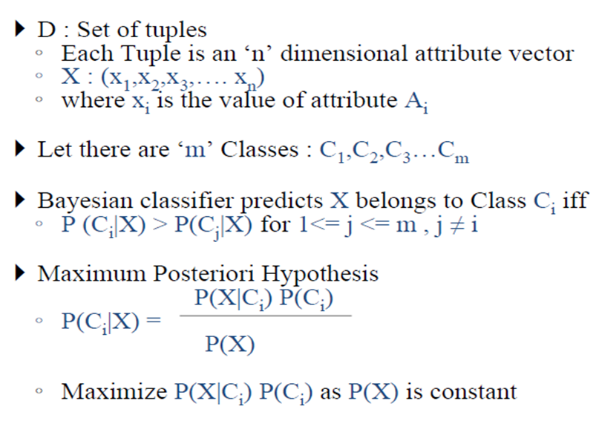
Bayesian Classifier

Slide 15
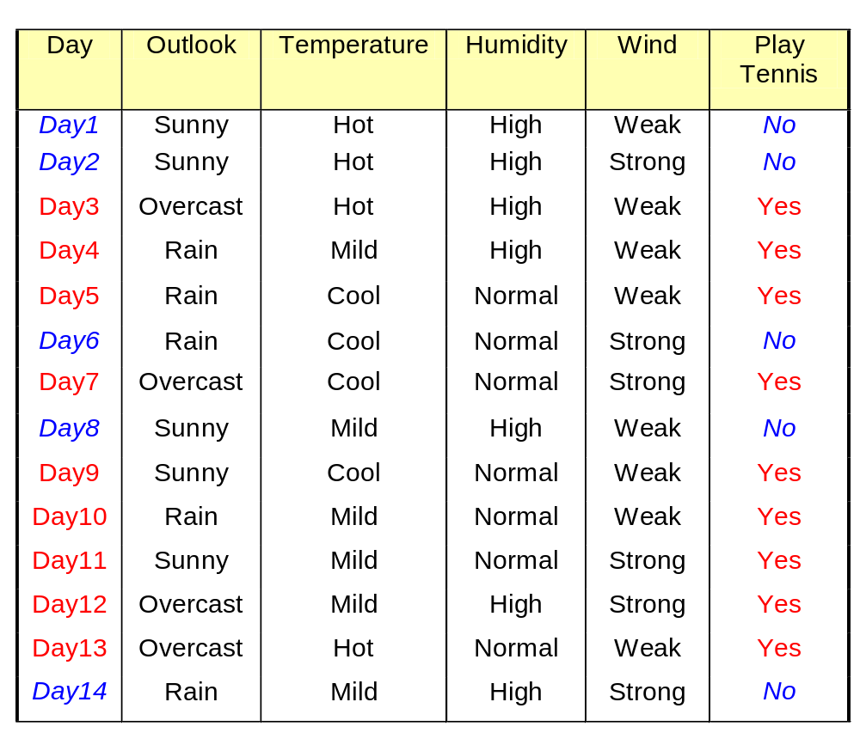
An Illustrating Example
Classifying days according to whether someone will play tennis.
Each day is described by the attributes, Outlook, Temperature, Humidity and Wind.
Based on the training data in the table, classify the following instance
Outlook = sunny,
Temperature = cool,
Humidity = high,
Wind = strong

Slide 16
An Illustrating Example
Training sample pairs (X, C)
X = (x₁, x₂, …, x_{n}) is the feature vector representing the instance.
C = (c₁, c₂, … c_{m}) is the desired (target) output of the classifier

Slide 17
An Illustrating Example
Training sample pairs (X, D)
X = (x₁, x₂, …, x_{n}) is the feature vector representing the instance.
n = 4
x₁= outlook = {sunny, overcast, rain}
x₂= temperature = {hot, mild, cool}
x₃= humidity = {high, normal}
x₄= wind = {weak, strong}

Slide 18
An Illustrating Example
Training sample pairs (X, D)
C= (c₁, c₂, … c_{m}) is the desired (target) output of the classifier
m = 2
c= Play Tennis = {yes, no}

Slide 19
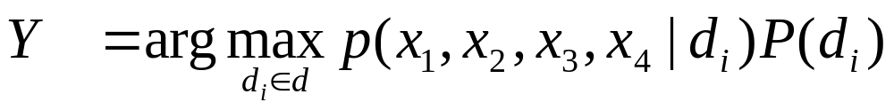
Bayesian Classification
P(c_{i}) is easy to calculate: simply counting how many times each target value c_{i} occurs in the training set
P(c = yes) = 9/14
P(c = no) = 5/14

Slide 20
Bayesian Classification
P(x₁, x₂, x₃, x₄|c_{i}) is much more difficult to estimate.
In this simple example, there are
3x3x2x2x2 = 72 possible terms
To obtain a reliable estimate, we need to see each terms many times
Hence, we need a very, very large training set! (which in most cases is impossible to get)

Slide 21
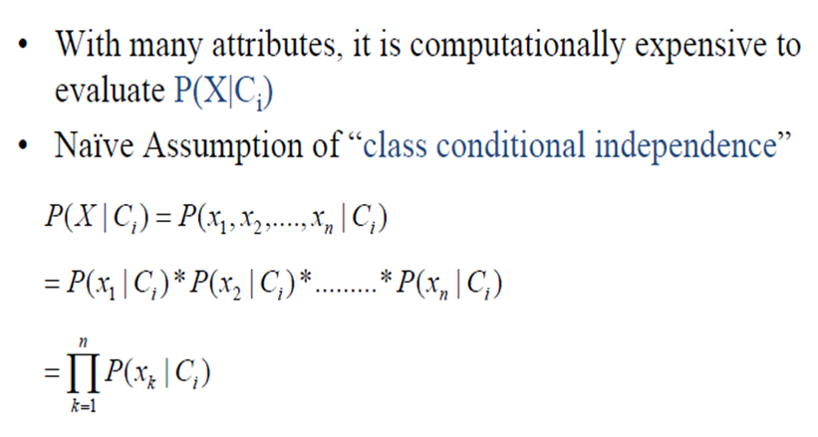
Naïve Bayesian Classifier...

Slide 22
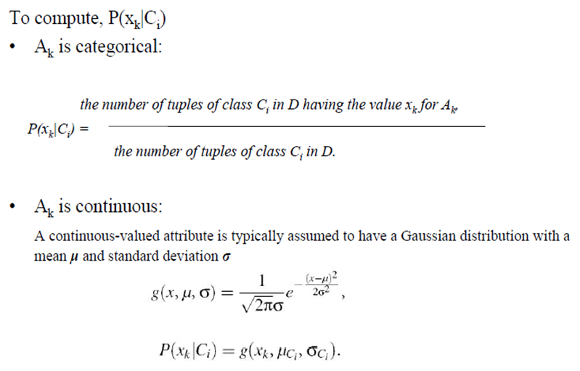
Naïve Bayesian Classifier...

Slide 23
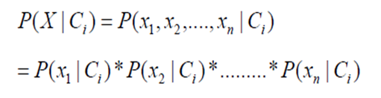
Basic assumption
The Naïve Bayes assumption is that all the features are conditionally independent given the class label.
Even though this is usually false (since features are usually dependent)

Slide 24
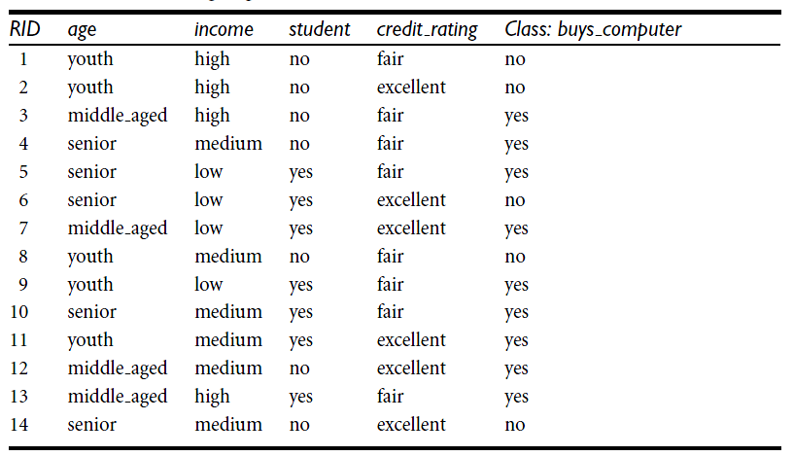
Example: Class-Labeled Training Tuples from the Customer Database

Slide 25
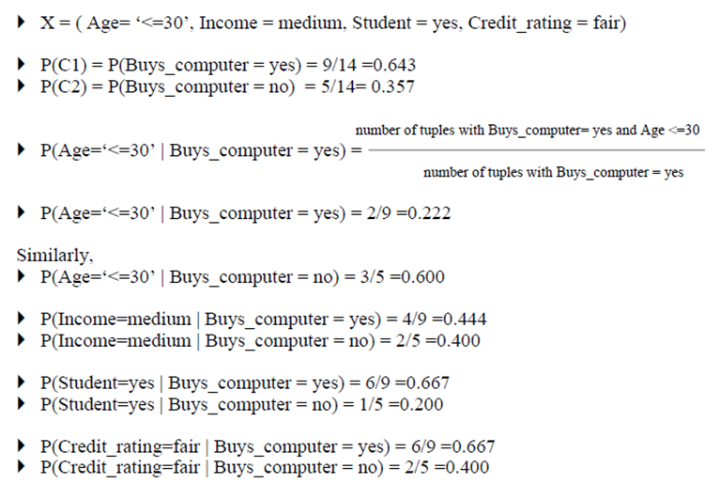
Example…

Slide 26
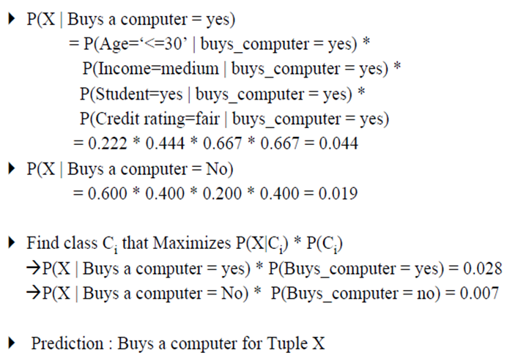
Example…

Slide 27
Second Example
< Outlook = sunny, Temperature = cool,
Humidity = high, Wind = strong >
Class Label?

Slide 28
Uses of Naïve Bayes classification
Text Classification
Spam Filtering
Hybrid Recommender System
  Recommender Systems apply machine learning and data mining techniques for filtering unseen information and can predict whether a user would like a given resource
Online Application
  Simple Emotion Modeling

Slide 29
Advantages and Disadvantages of Naïve Bayes
Advantages :
  Easy to implement
  Requires a small amount of training data to estimate the parameters
  Good results obtained in most of the cases

Slide 30
Advantages and Disadvantages of Naïve Bayes
Disadvantages:
  Assumption: class conditional independence, therefore loss of accuracy
  Practically, dependencies exist among variables
  E.g., hospitals: patients: Profile: age, family history, etc.
  Symptoms: fever, cough etc., Disease: lung cancer, diabetes, etc.
  Dependencies among these cannot be modelled by Naïve Bayesian Classifier

Slide 31
Bayesian Learning
Reference
Sections 6.1 – 6.2 of T. Mitchell
Section 6.7
Section 6.9 - 6.9.1

